Slide 1
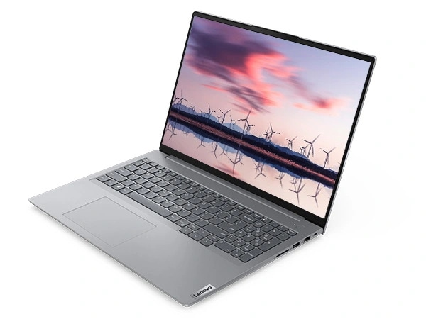
College name – Lamrin Tech Skills University Punjab Course name – Design Thinking & Critical Thinking Branch- Btech (Electrical Engineering) Presented by – Sudhir Bhardwaj Roll No- 24100130006 Task no #1- Product Failure Analysis , Machine Failure Analysis
Title : Failure Analysis of Lenovo Thinkbook 16 Gen 6 Laptop Subtitles: Understanding issues, causes, and potential solutions Here`s a failure analysis of a laptop (Lenovo thinkbook 16 gen 6 using an excel sheet .

